Slide 1


Great Climates, Big Cities?
Kansas Populations: a look at wealth, weather, migration, and employment

Slide 2
Topic:Unemployment Rates and Poverty Data
***Notes to be removed
Question
Approach
Code
Discovery process

Slide 3
Documentation
https://public.opendatasoft.com/

Slide 4
Overview

Slide 7
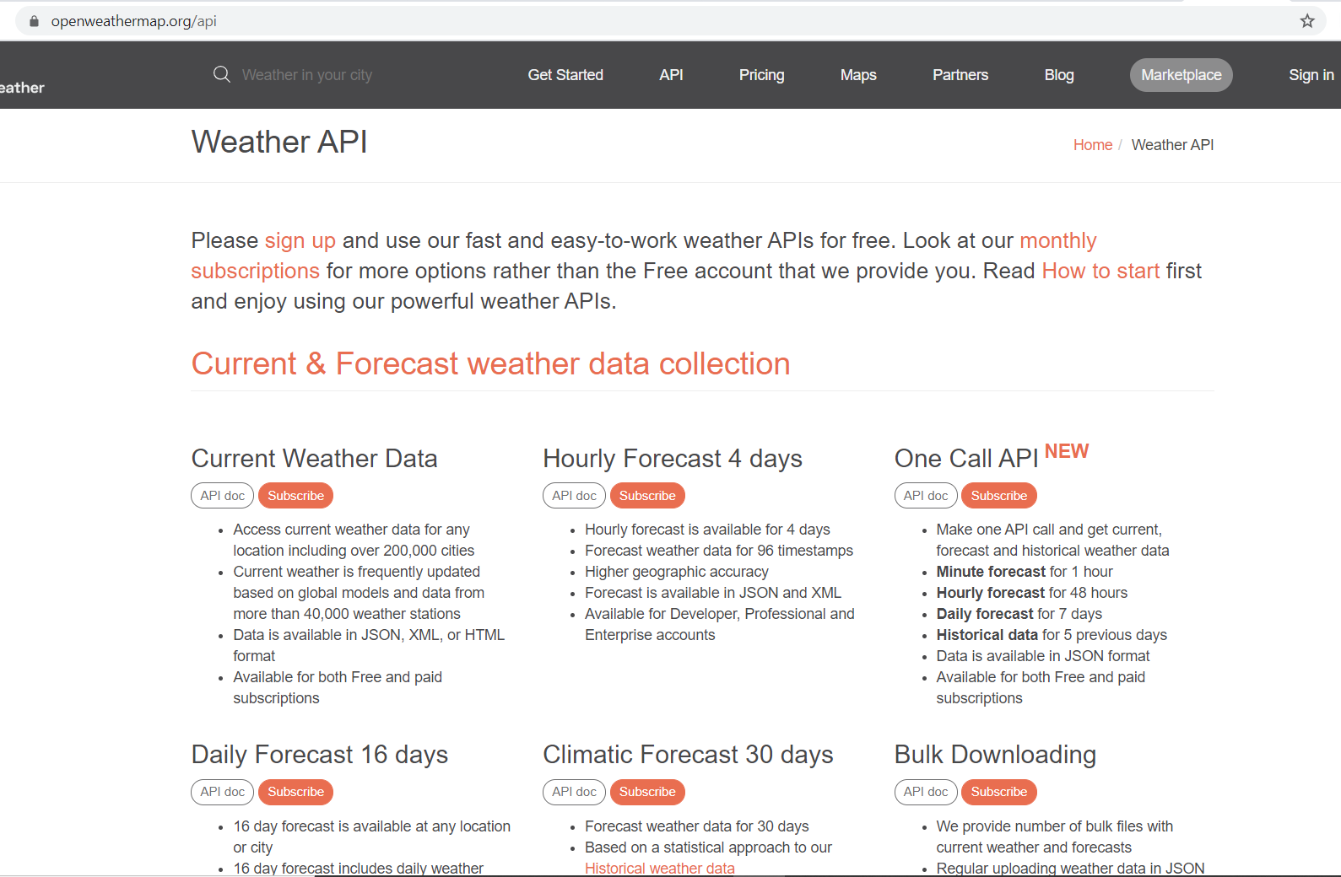
Data source used for gathering temperature data was the Open Weather API
5 day history

Slide 8
